Slide 1
Review Analysis
Group 5: Shiyu Jiang, Jianjia Liu, Caisen Mo, Danni Zhang

Slide 2
Content
Research Questions
Data Used
Technique Used
Results
Recommendation

Slide 3
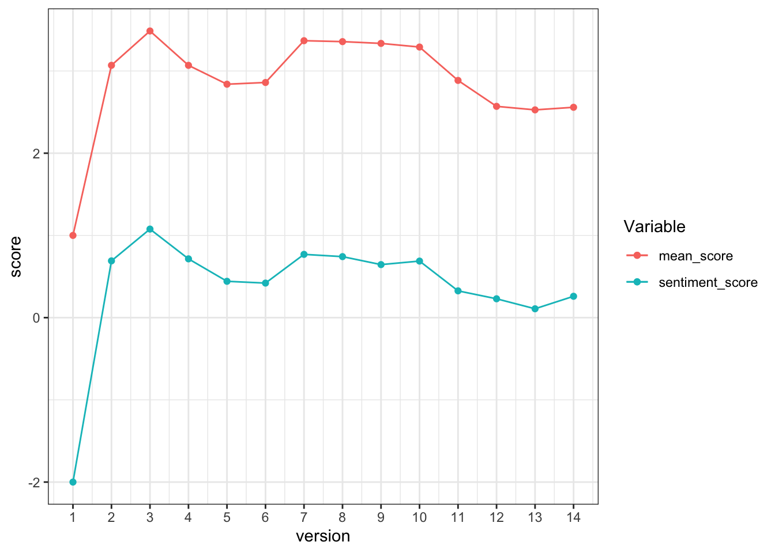

Research Questions
Based on the review content, what is users’ overall attitude towards Tinder?
How are review contents related to users’ rating scores of the Tinder app?
What are the key features that make users have a positive/negative attitude?
Analyze from 2 dimensions:
Rating score under 3/above 3
rating score over 13 different version
Notes:
Explain in more detail

Slide 4
Dataset
Technology Used
User reviews for Tinder app available at Google Play Store
Time range: July 2013 - February 2023
Cleaned dataset: 19552 observations with 13 variables
Sentiment Analysis
Overall attitude towards Tinder
Specific emotions expressed
Sentiment score
Predictive Analysis
Text features
Future review scores and user satisfaction
Topic Model for rating score and version

Slide 5
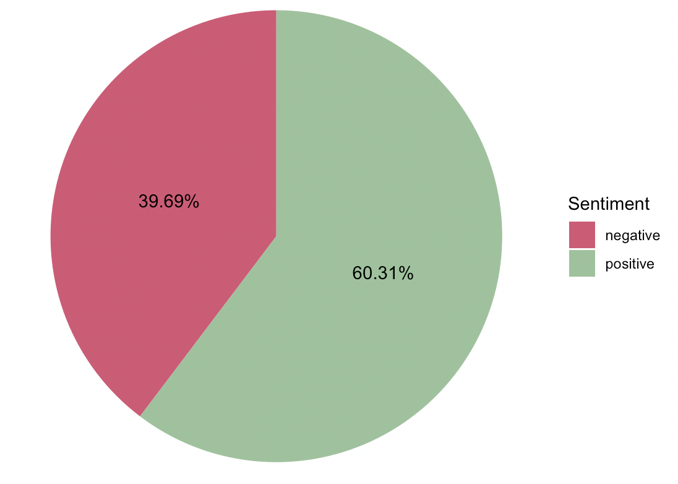
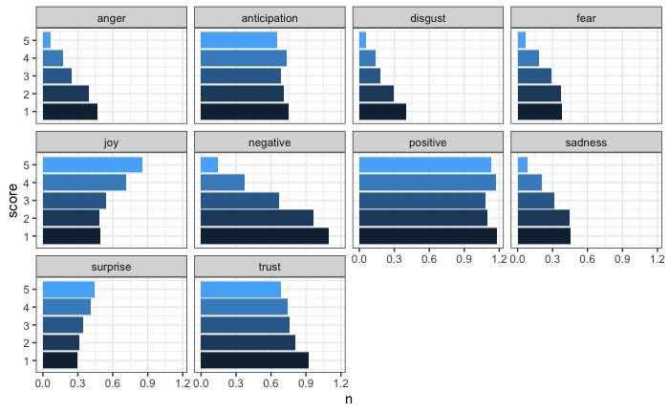
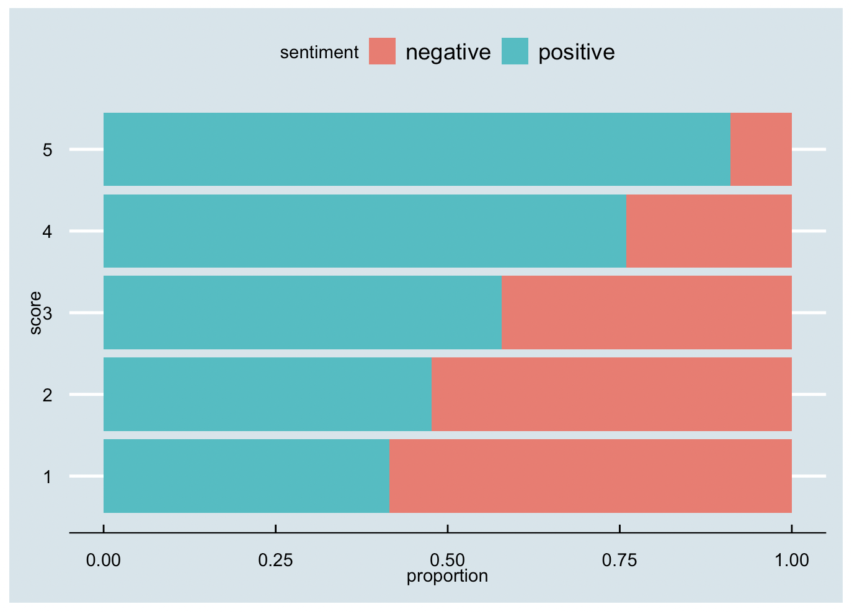
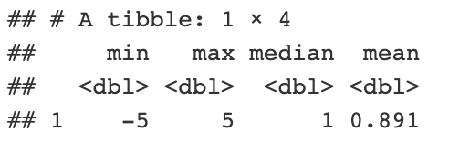
Sentiment Analysis

Slide 6
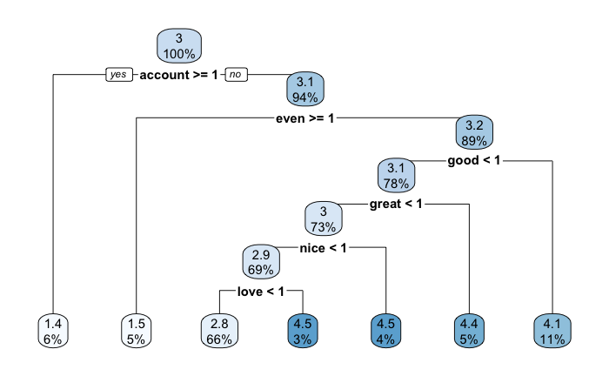
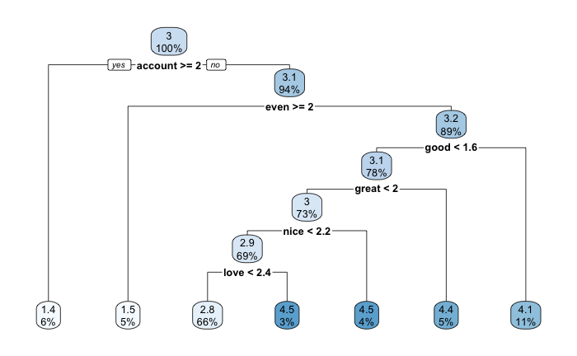
Predictive Analysis
TF features
TF-IDF features

Slide 7
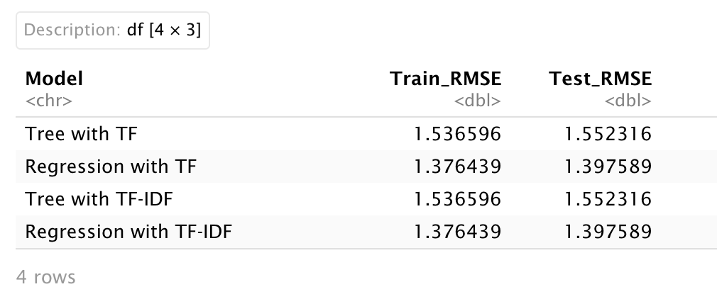
Predictive Analysis Result

Slide 8
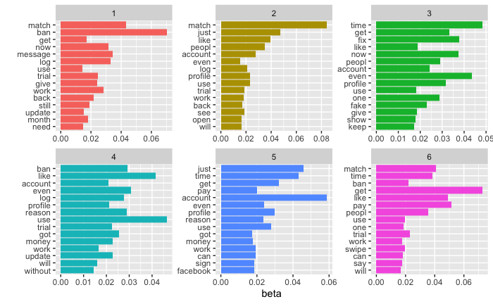
Topic Model: Rating under 3
Topic 1: fake accounts, bans, and deletions
Topic 2: technical aspects of the app, including logins, updates, and crashes.
Topic 3: user interactions, including matches, profiles, and messaging.
Topic 4: issues with payments, trials, and subscriptions.
Topic 5: user interactions, with terms like “people”, “matching”, and “accounts” being prominent.
Topic 6: general user experience issues, including time wasted, money spent, and work required.

Slide 9
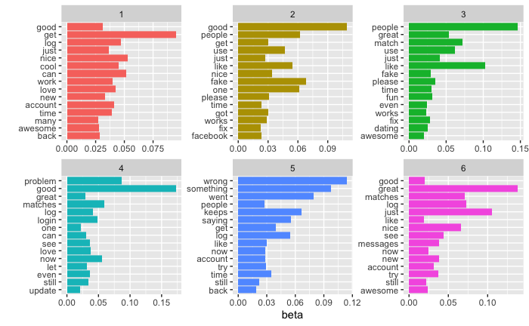
Topic Model: Version 13
Topic 1: Matches and finding people on the app ("matches", "get", "love")
Topic 2: Negative experiences or suspicions about fake accounts ("fake", "many")
Topic 3: Positive feelings about meeting new people in Tinder ("people", "great", "like")
Topic 4: Technical issues related to logging in or using the app ("log", "account", "login")
Topic 5: User complaints or concerns ("something", "wrong")
Topic 6: Positive experiences with the app ("great", "good", "awesome")

Slide 10
Conclusion & Recommendations
Continuous optimization of the matching algorithm
continually collect and analyze user behavior data to improve the accuracy and relevance of its match suggestions, such as swiping patterns, messaging history, and user’s time spent on the app
Reduce fake profiles and bots
invest in advanced fraud detection and prevention technologies to identify and block fake accounts.
Enhance safety features
include features such as video verification, background checks, real-time location tracking, sharing features and user feedback mechanisms to help users assess the safety of potential matches.
Positive aspects:
“nice match”
Negative aspects:
A common complaint among users is the number of fake profiles and bots on the app.
Technical issues such as app crashes can also be a significant problem
Some users have reported feeling unsafe on the app, especially when meeting up with matches in person.

Slide 11
Thank You!

